Slide 1
DATEMANDU
CodexOrient

Slide 2
INTRODUCTION
DATEHACK – 24-hour hackathon
Valentine Season
Online Dating

Slide 3
Problem Statement
Difficulty in finding and interacting with the perfect partner in this huge pool of people.
Many international solution – but not that much applicable in context of Nepal

Slide 4
Solution
DATEMANDU
an online matchmaking platform that will help them to find the companion they are looking for

Slide 5
AIM
create a profile and search for suitable partners
Unlike currently system DATEMANDU aim for effectiveness and time saving ( considering only Nepali market )

Slide 6
OBJECTIVE
Make use of new and improved technology to bring innovation to be socialize by advertising online.
Provide online matching of compatible clients. (Example: Matching through horoscope)

Slide 7

METHODOLOGY
Problem Identification
Designing
Implementation

Slide 8
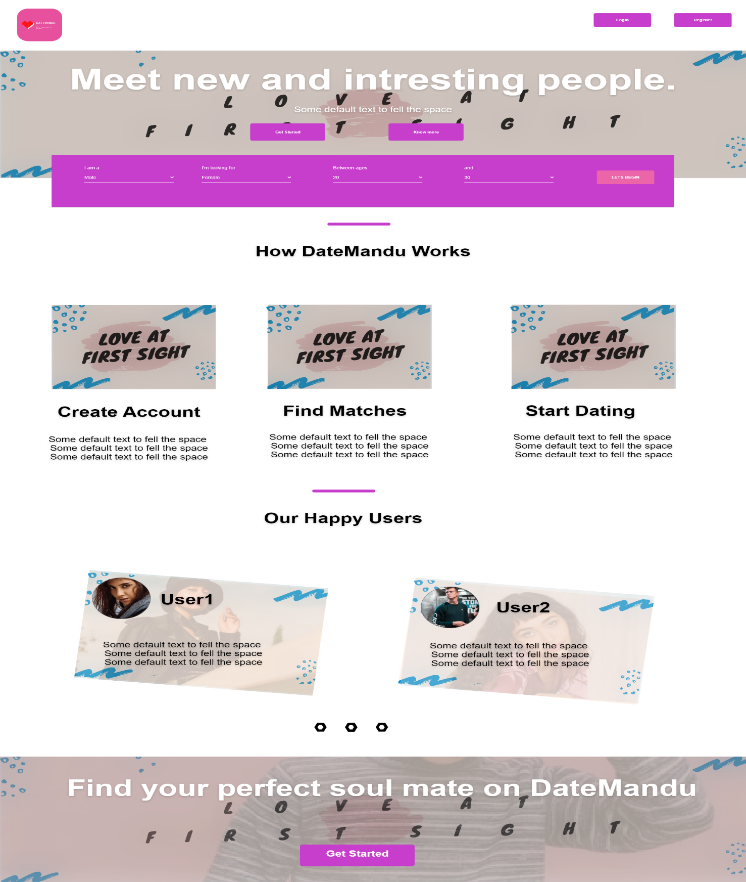
PROPOSED SYSTEM

Slide 9
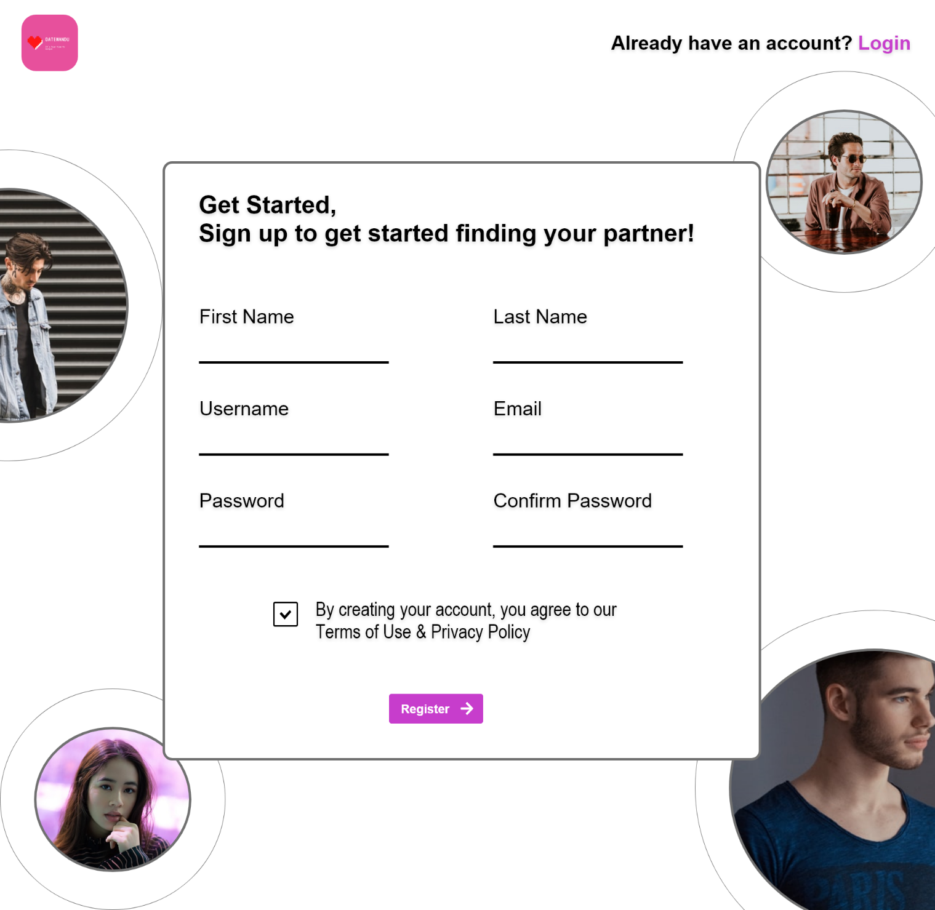

Slide 10

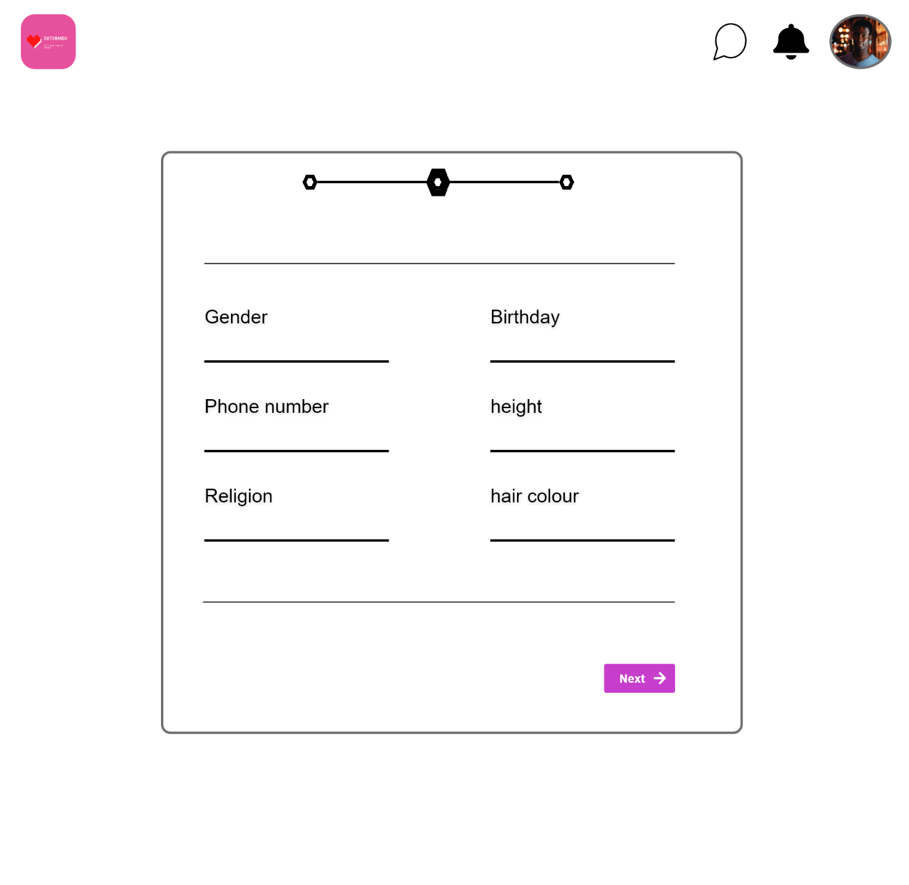
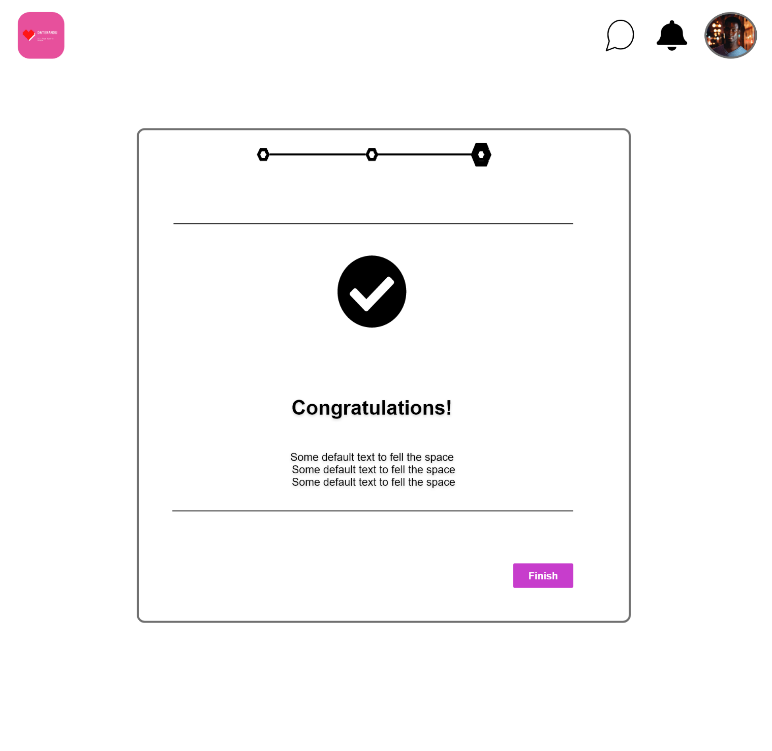

Slide 11
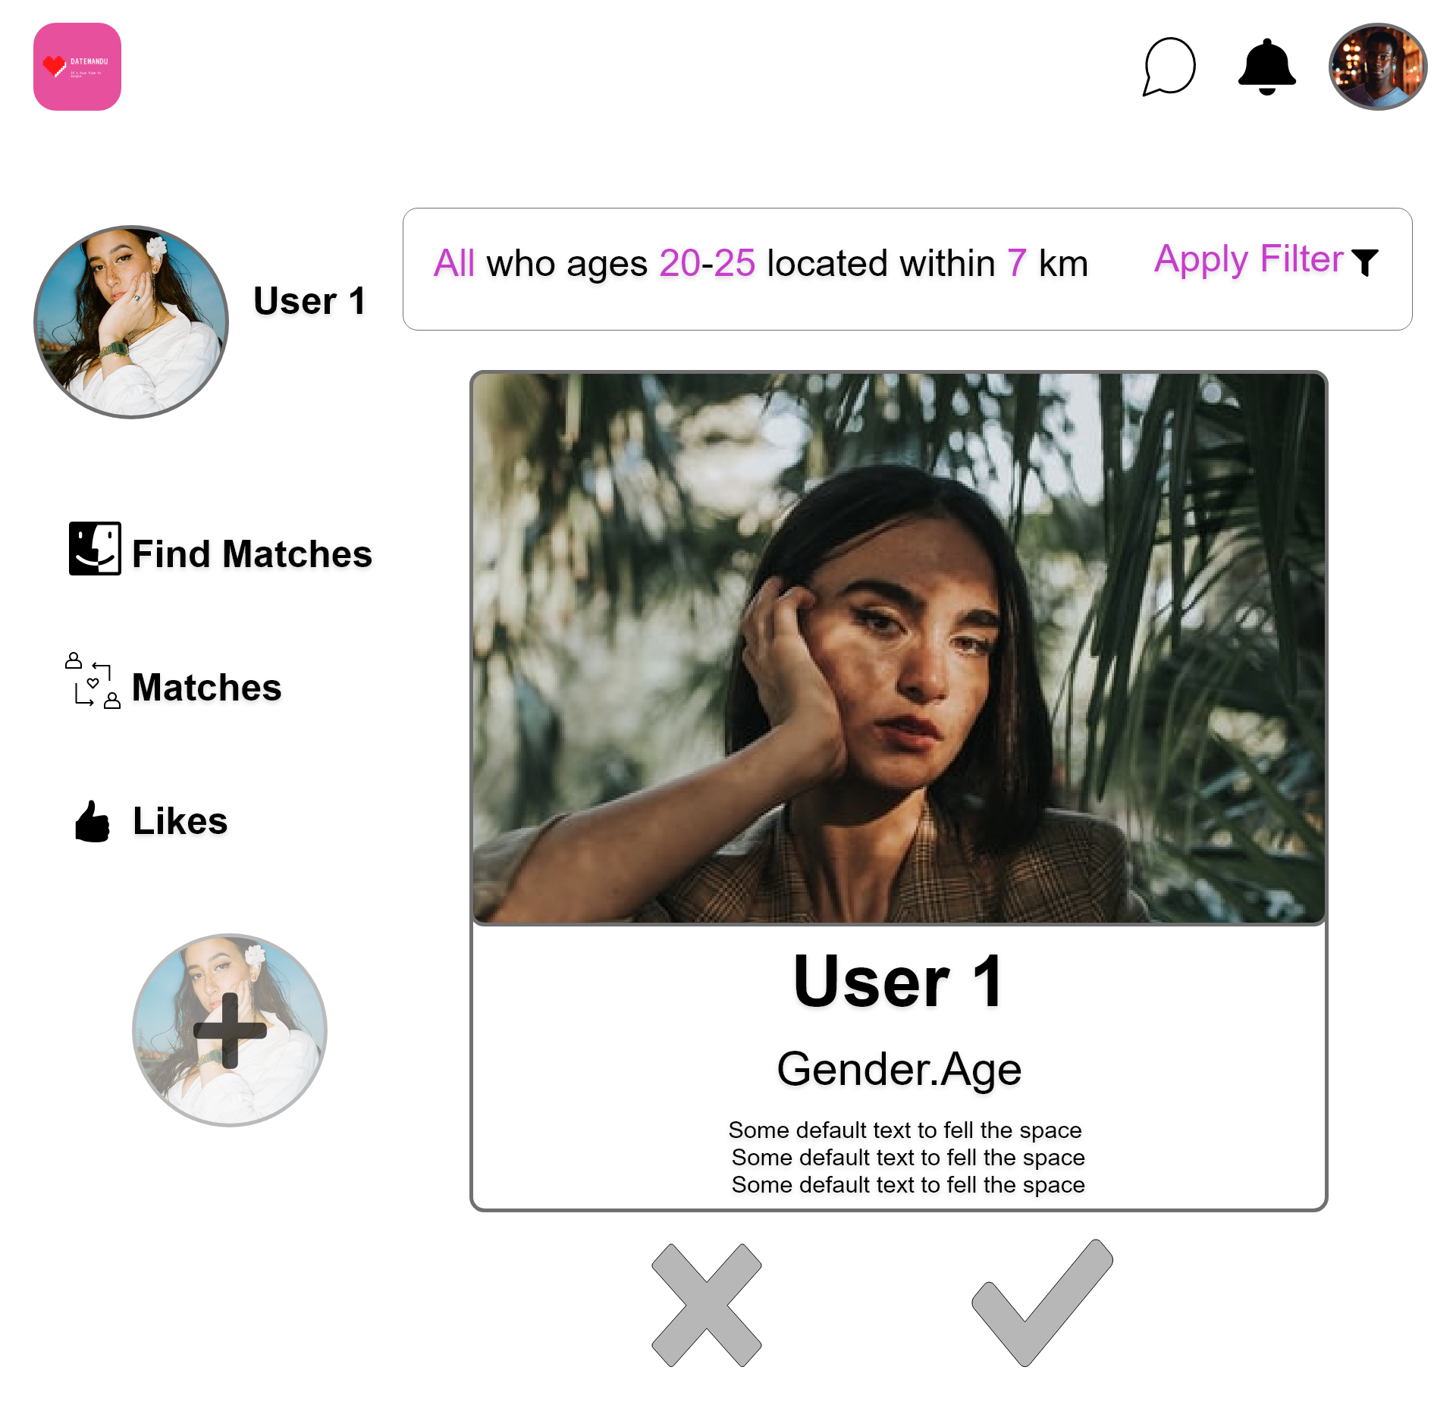
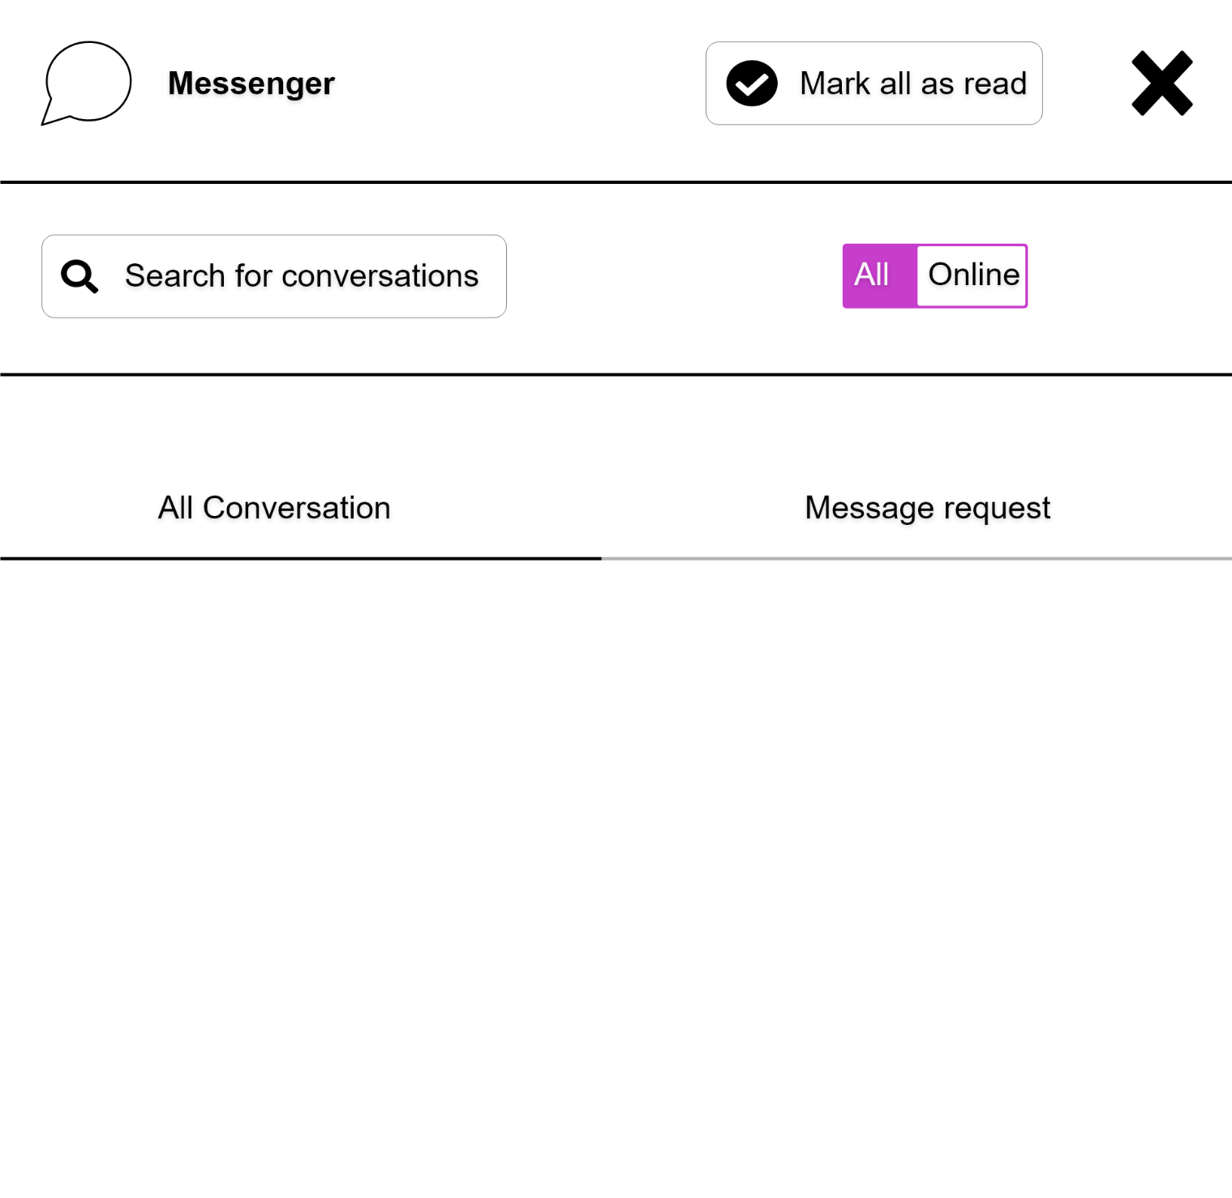

Slide 12
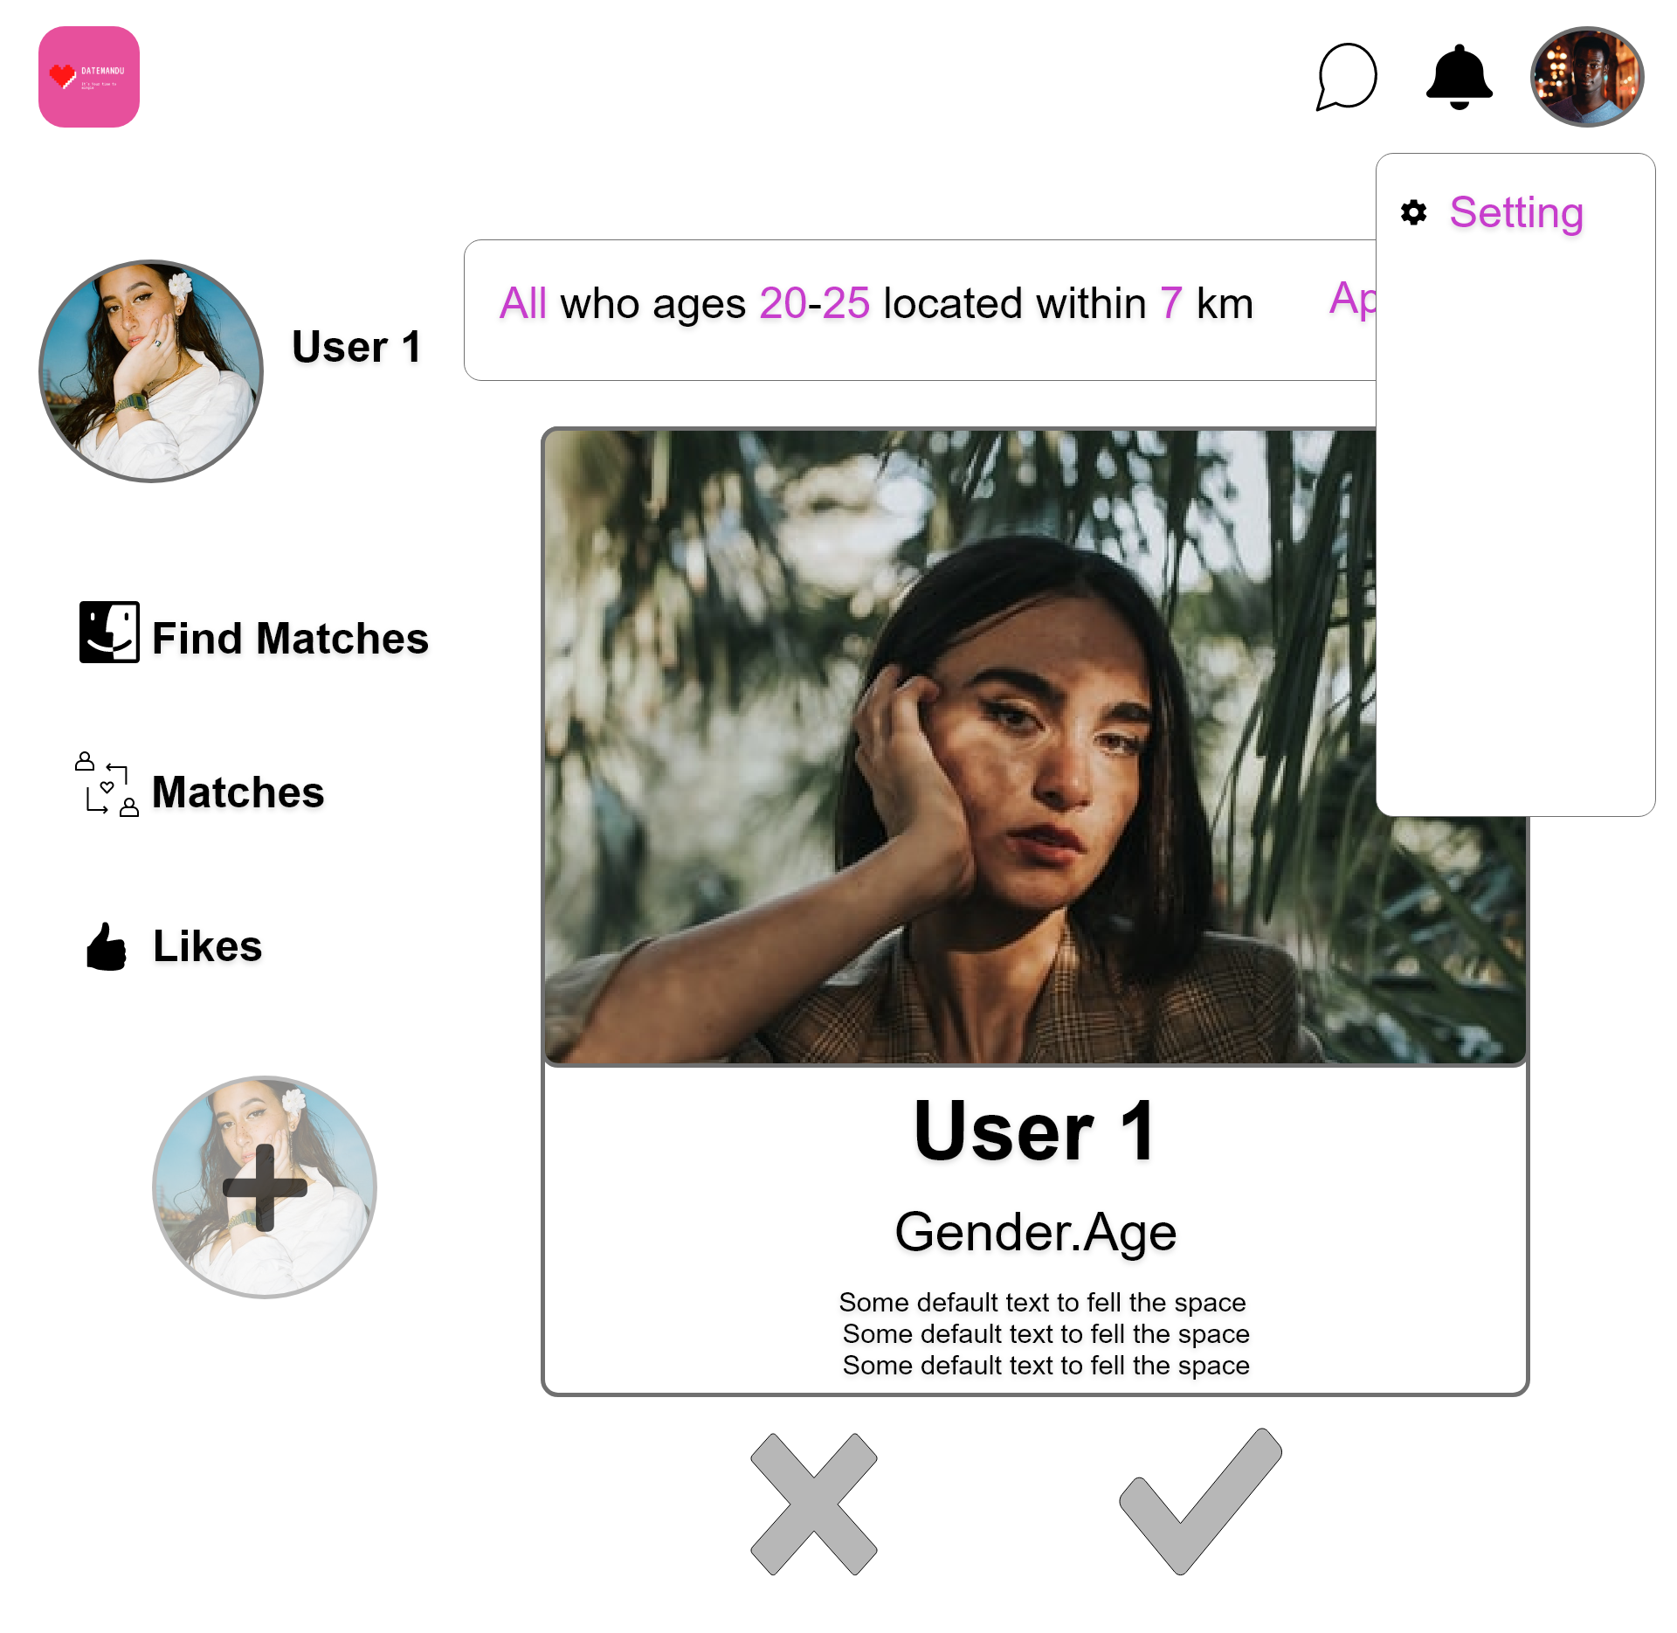
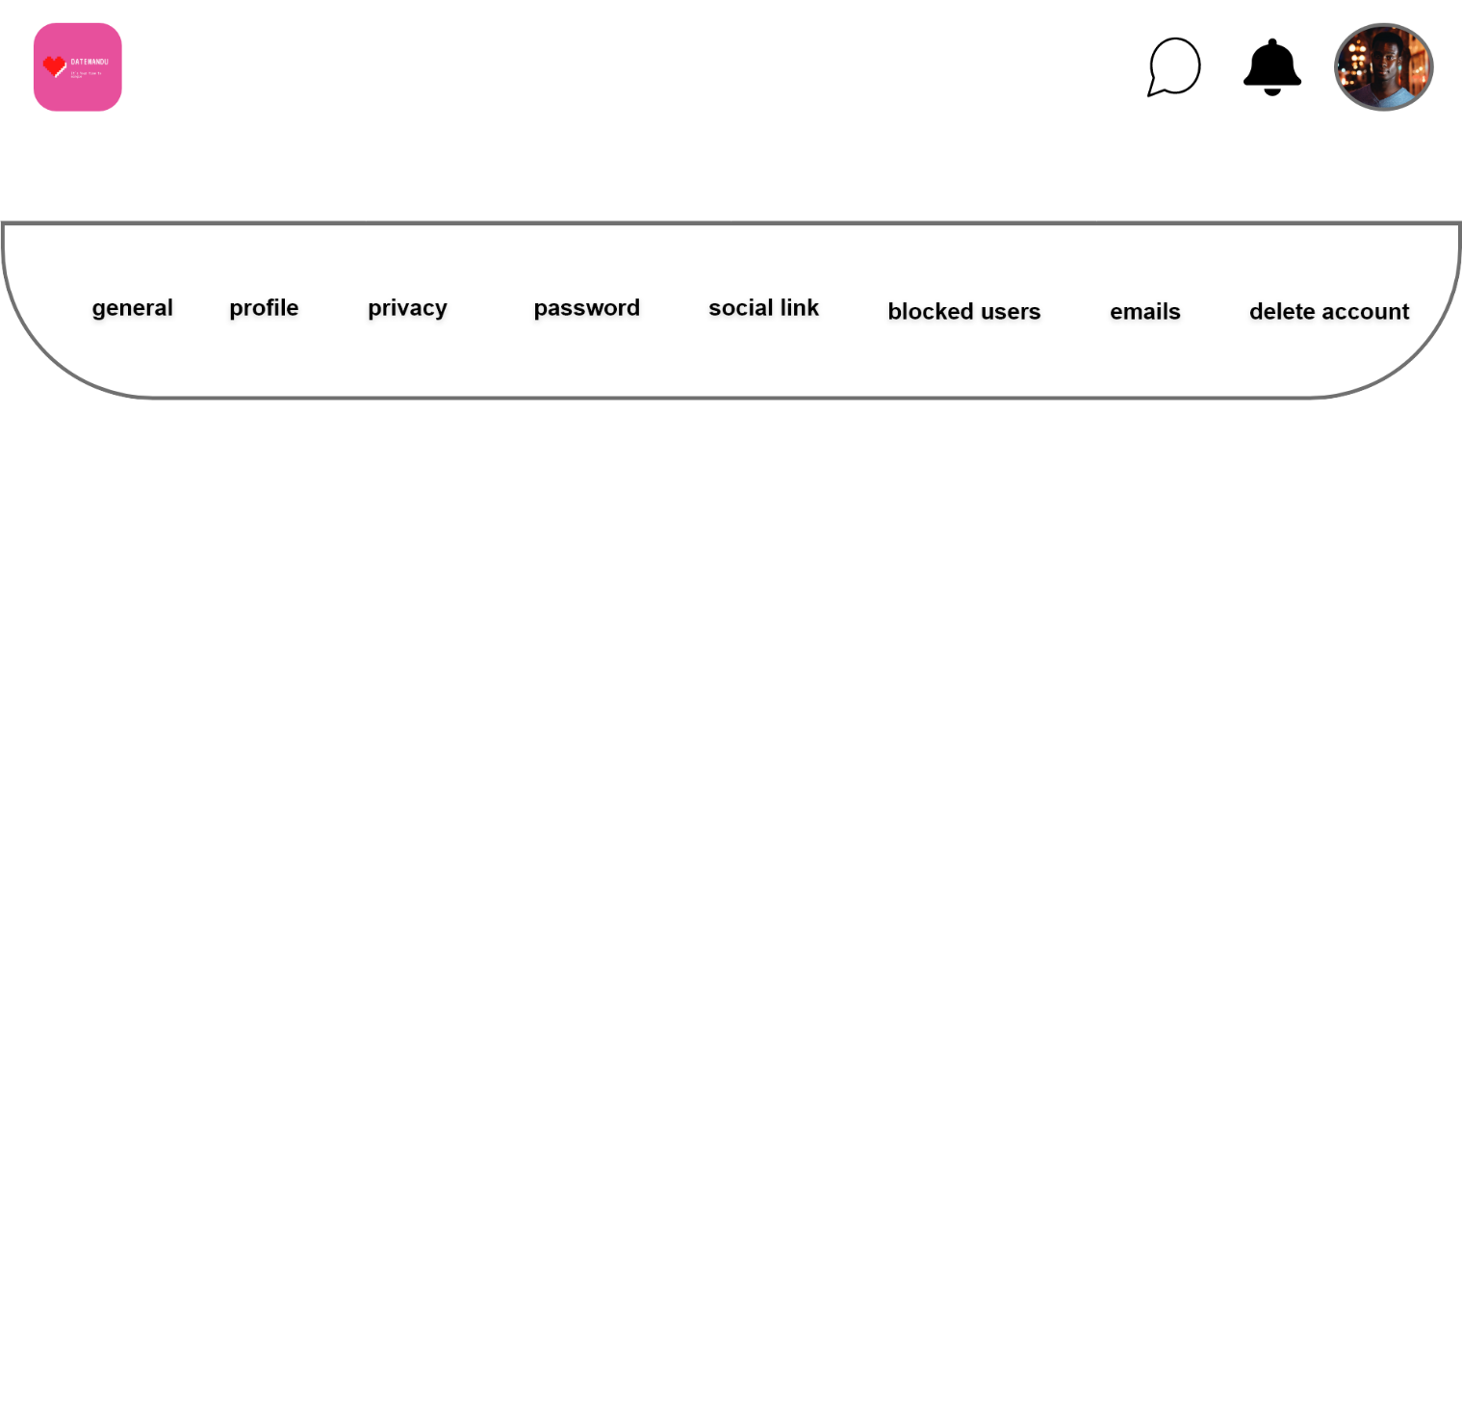

Slide 13
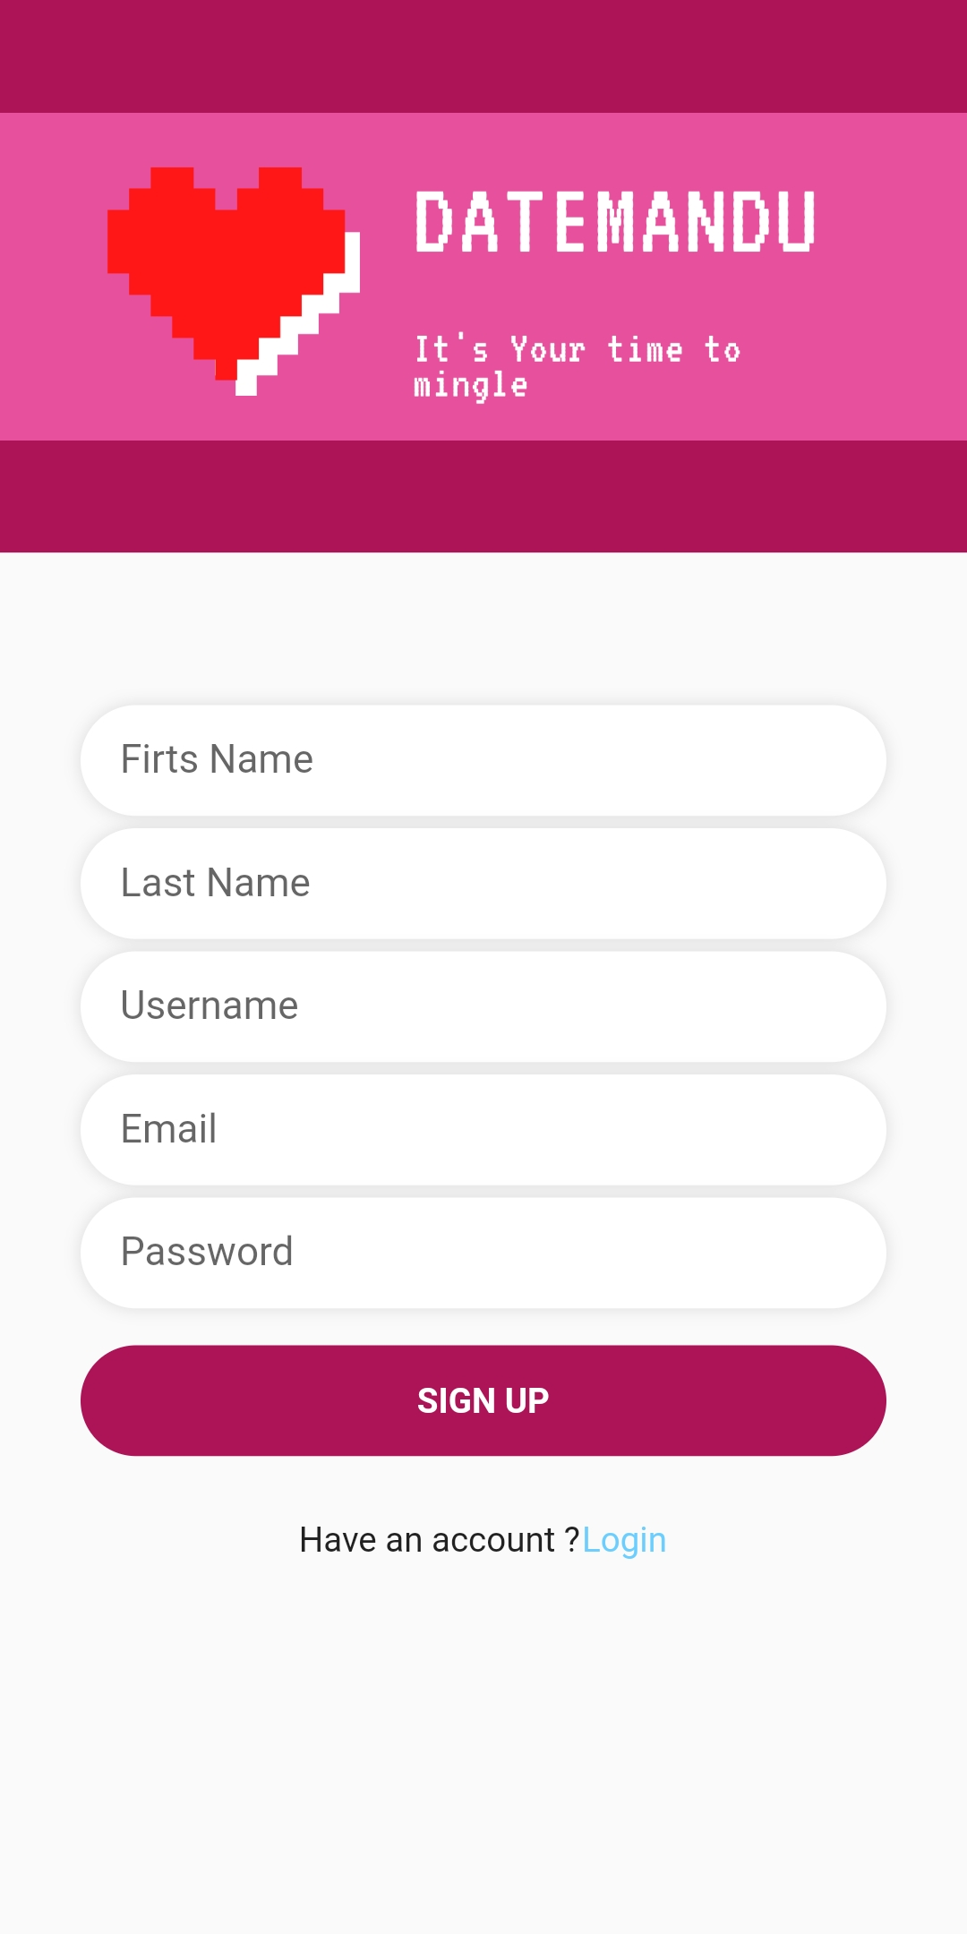
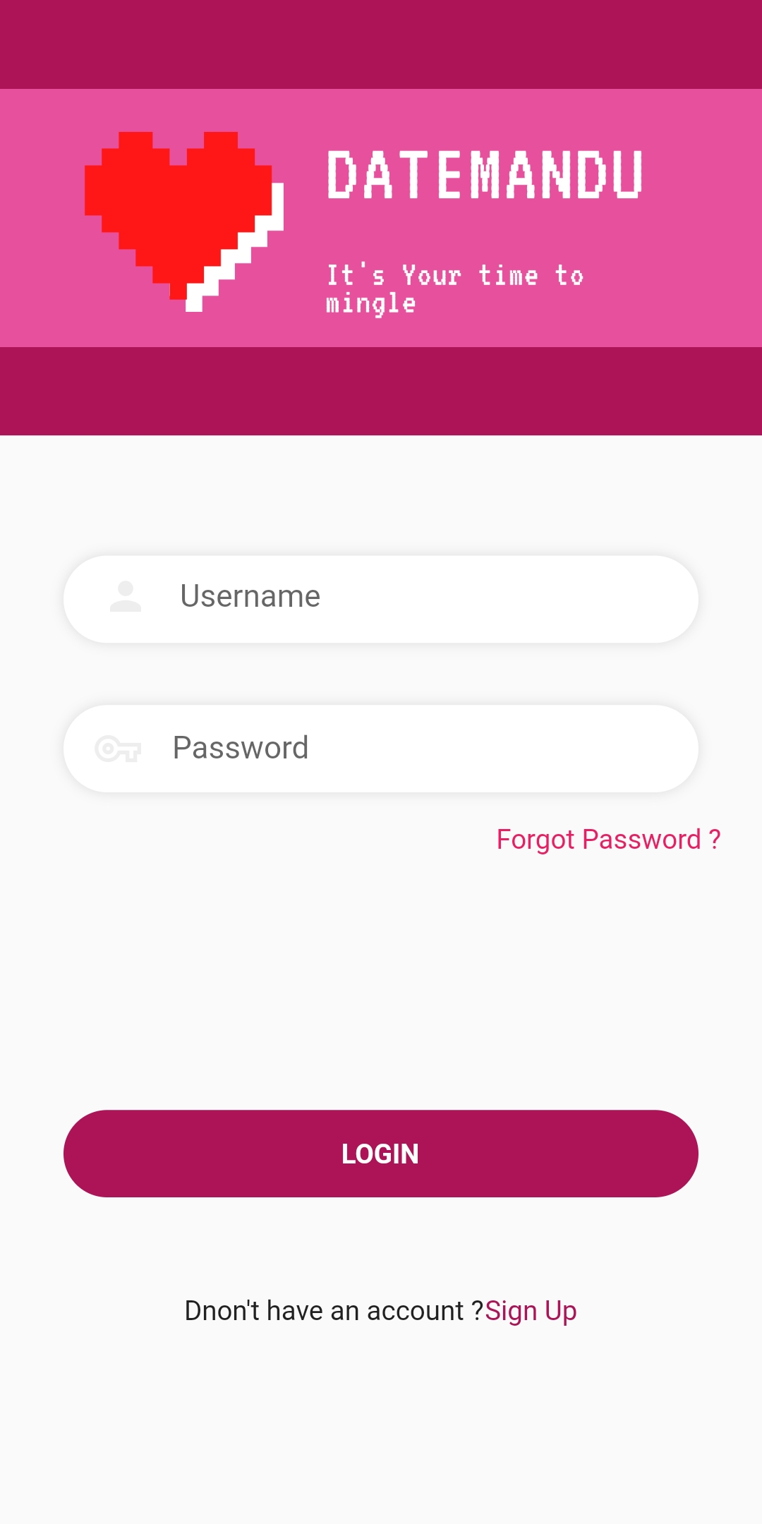
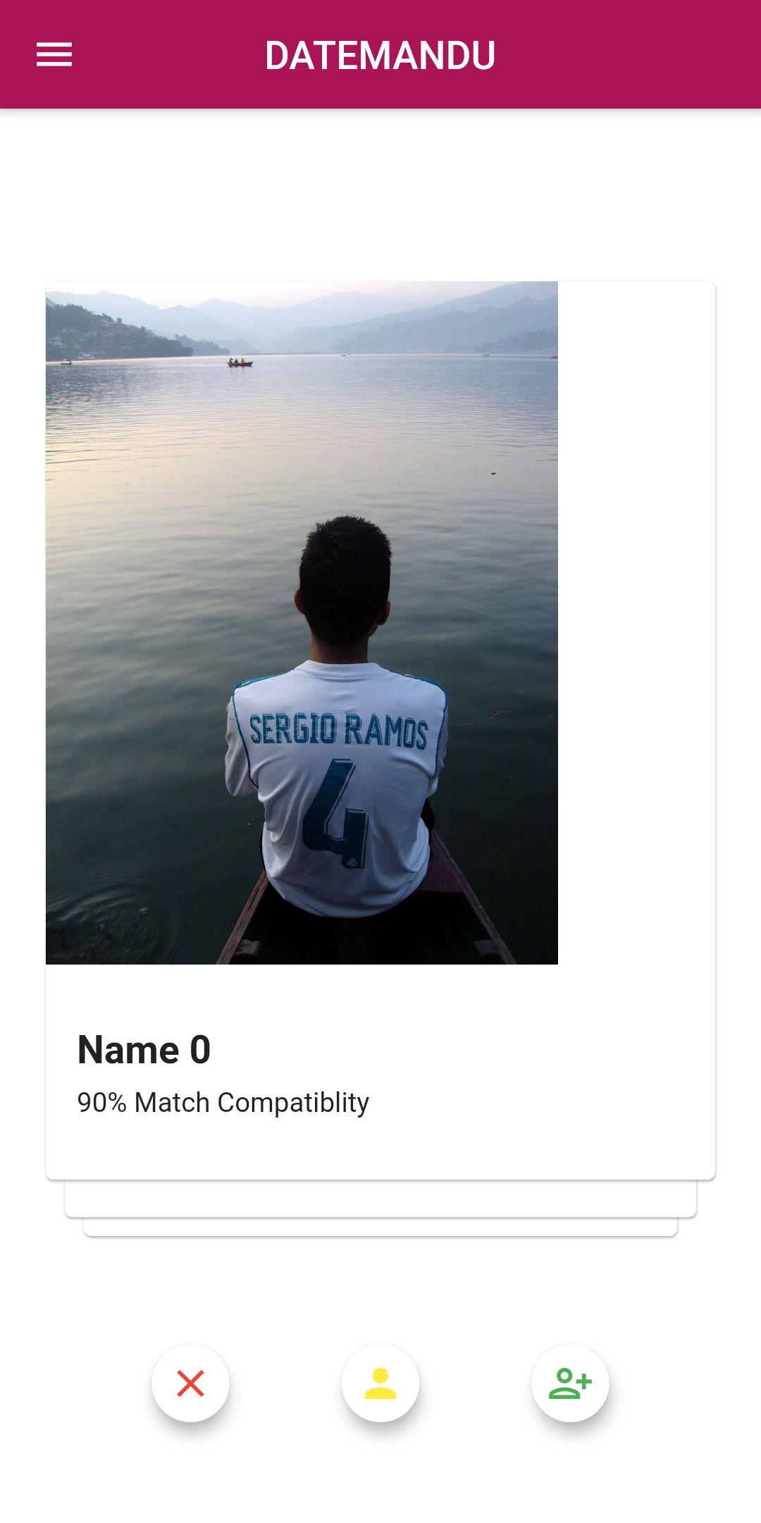

Slide 14
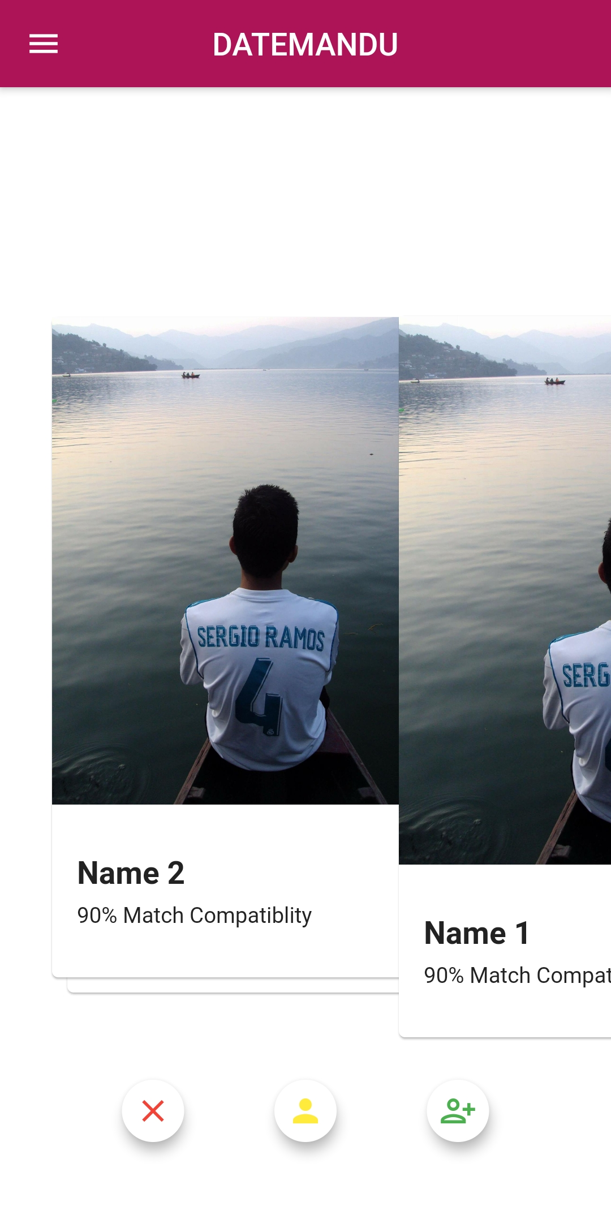
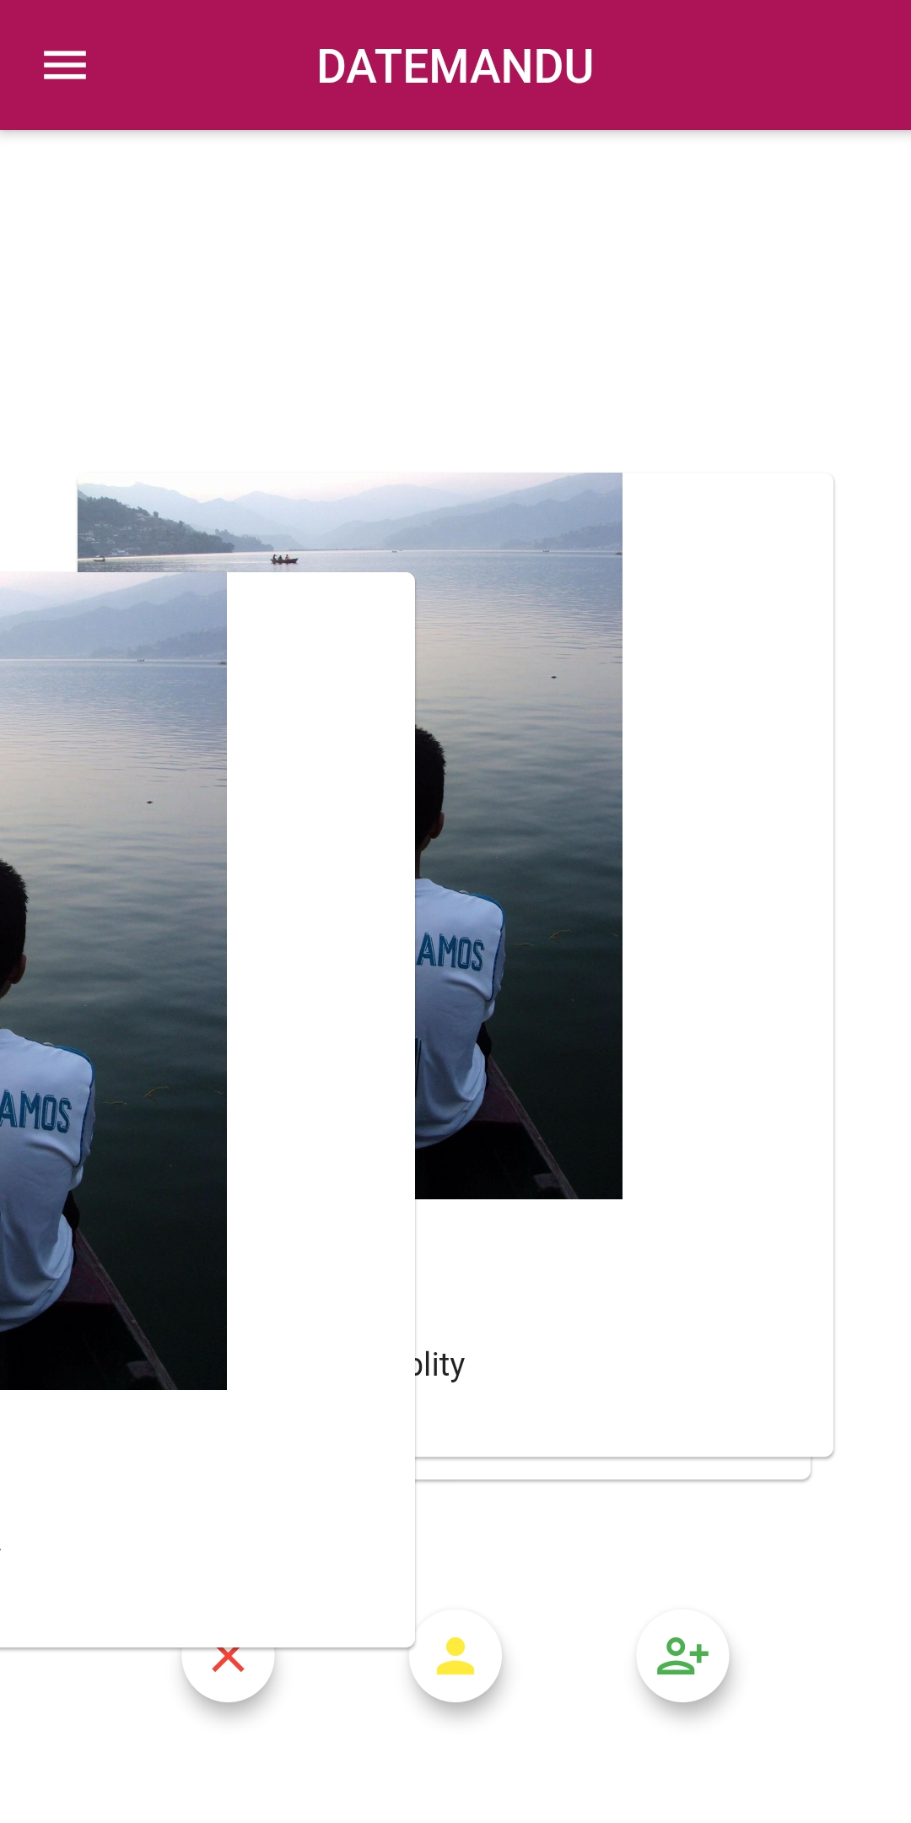

Slide 15
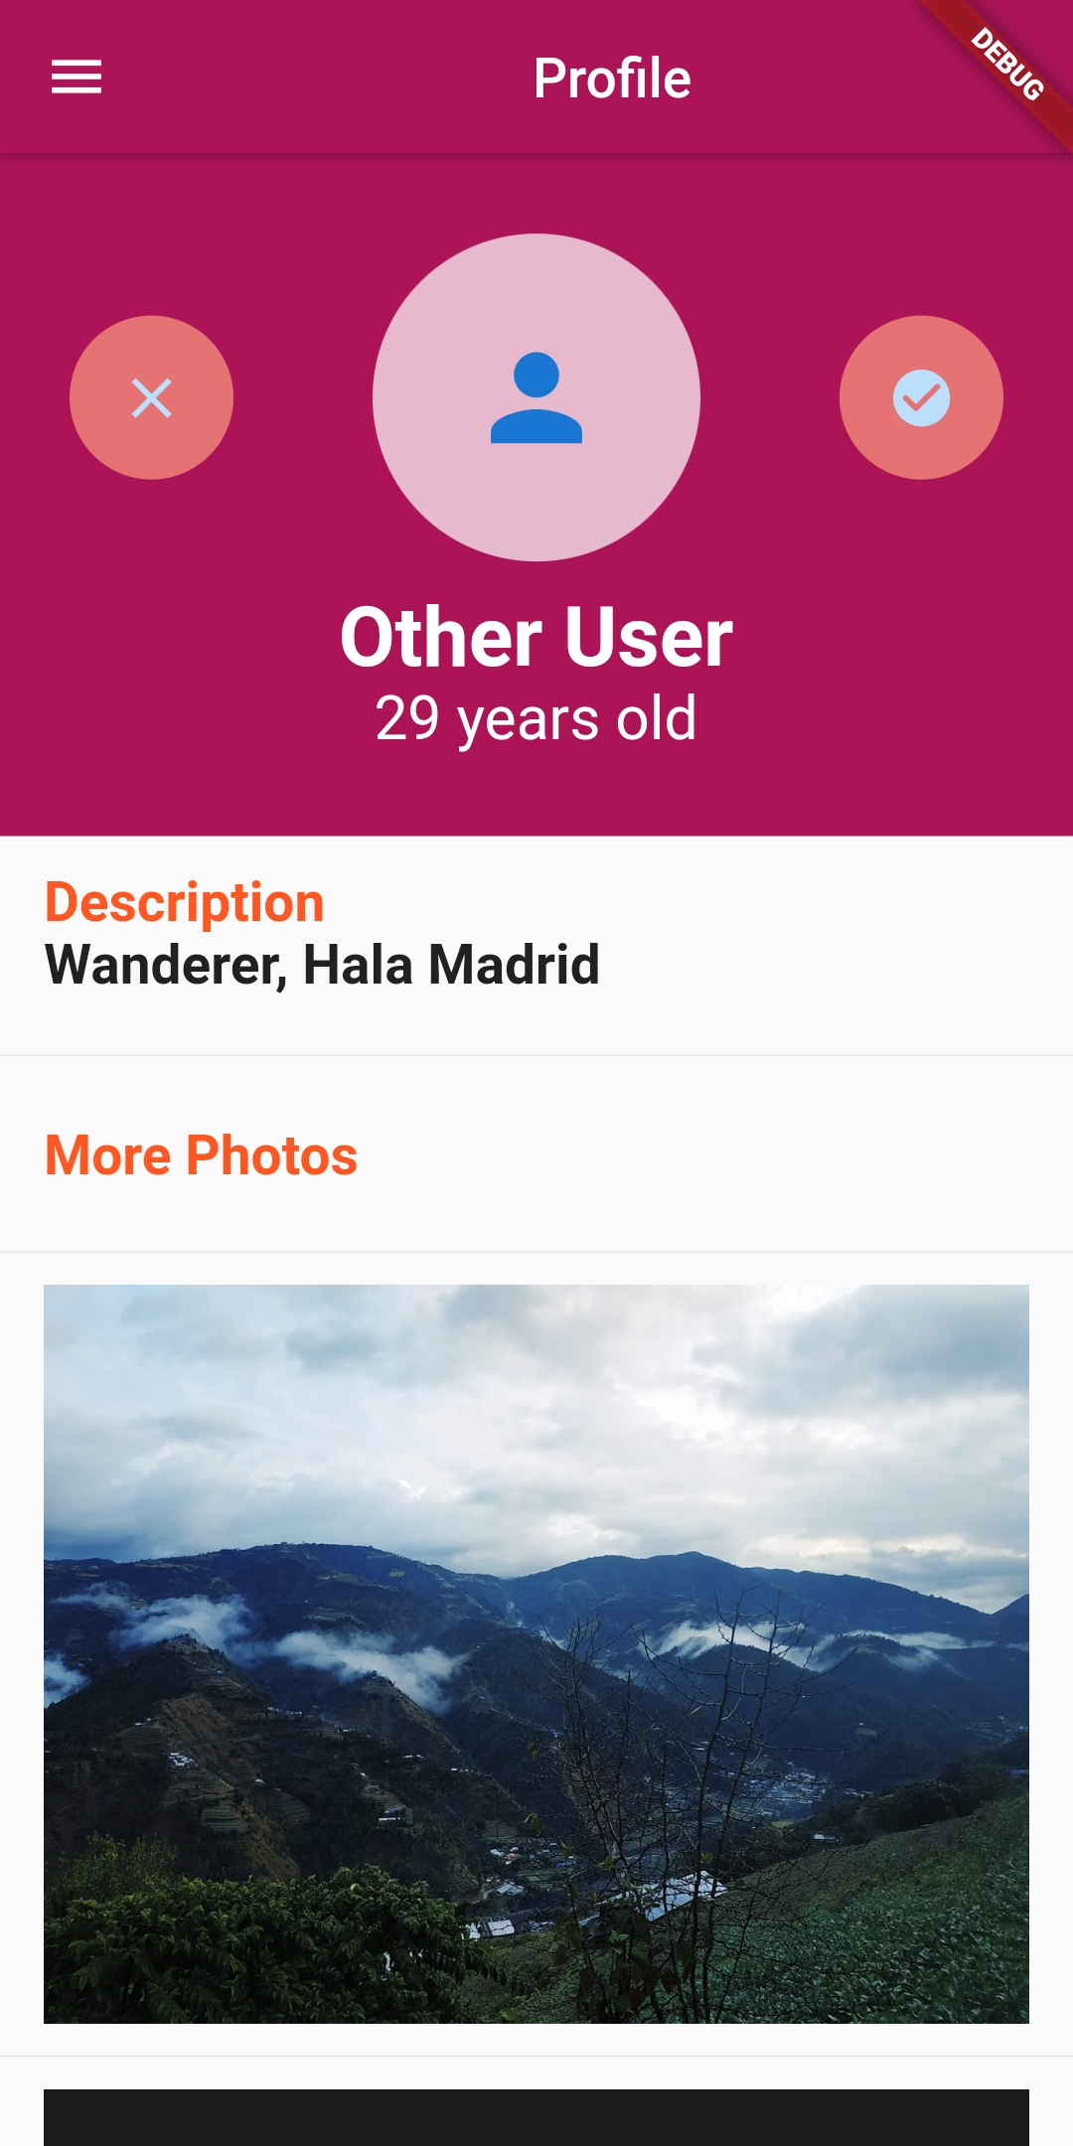
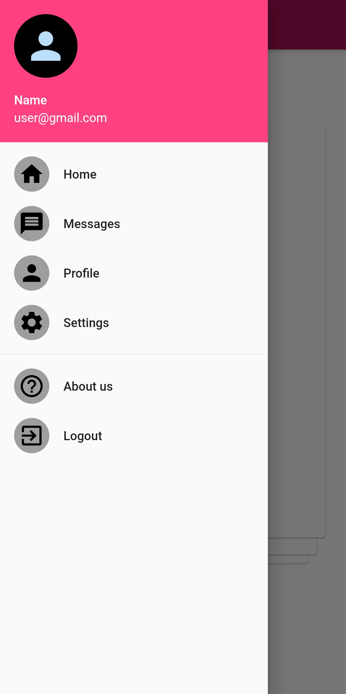

Slide 16
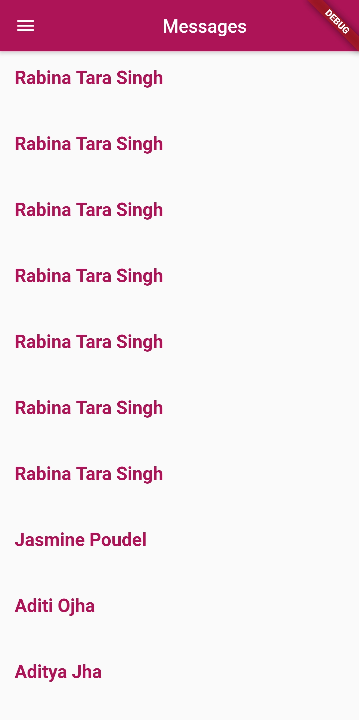
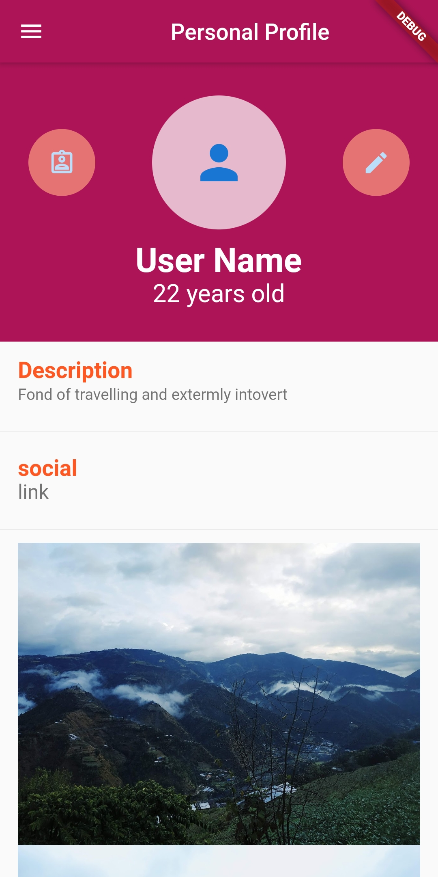

Slide 17
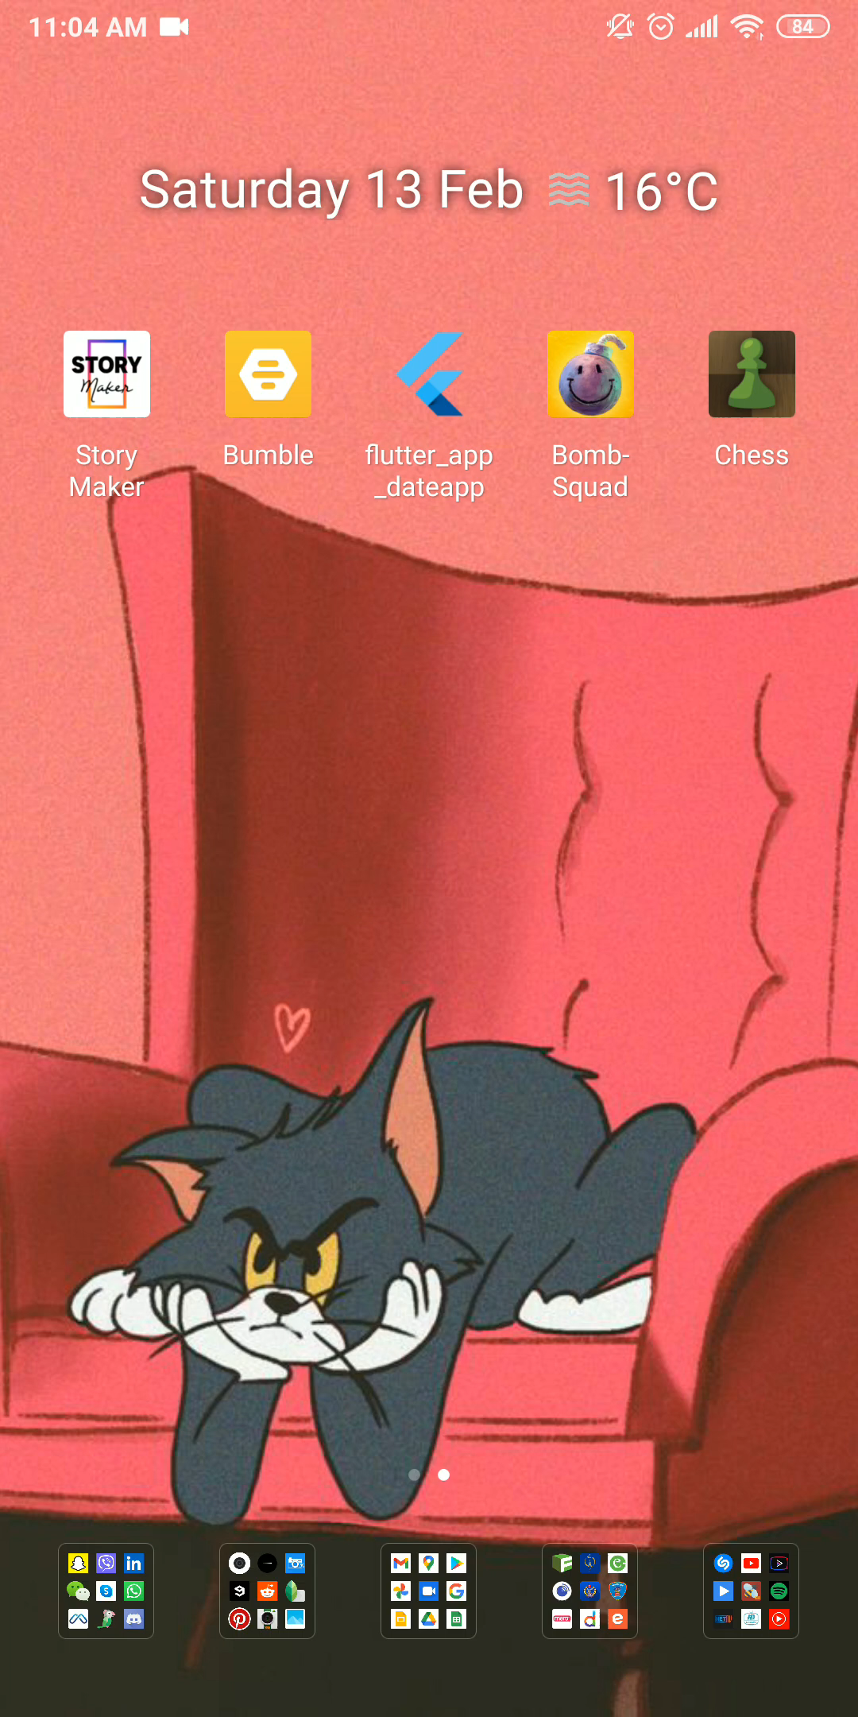

Slide 18

BENIFITS
Matching through horoscope
Fast profile matching
Increased customer satisfaction
Fewer Complaints
Increased reliability

Slide 19
Future Enhancement
Personalized Advertisement
Voice and video chat
Security enhancement
Making app interactive with different games

Slide 20
Conclusion
International dating apps are not convenient for Nepali users
People are still facing the difficulty to find their perfect partner
DATEMANDU is created to lessen the difficulty
More feature could be added in future

Slide 21

ANY QUERIES

Slide 22


THANK YOU

